Slide 1

Introduction to Jenkins
Module 4: Pipeline Deep Dive

Slide 2
Topics
Scripted vs Declarative Pipeline
Stages, agents, environment blocks
Parallel execution and matrix builds
Docker agents within pipelines

Slide 3
Scripted vs Declarative Pipeline
Both pipeline types use Groovy
  They differ in structure and intent:
Scripted pipeline
  Jenkins runs the script as a Groovy program
Declarative pipeline
  Jenkins interprets the code as describing a structured workflow
  Translated into executable Groovy code

Slide 4
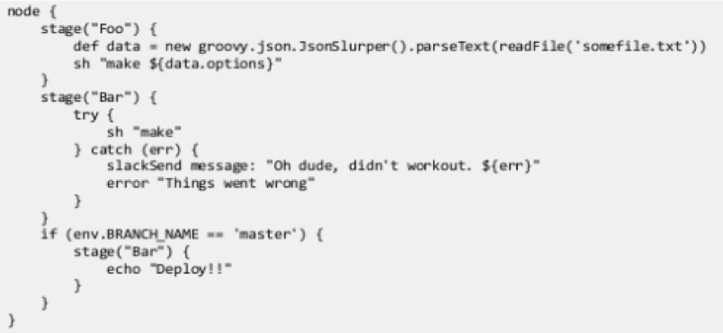
Scripted Pipeline
Characteristics
  Free-form Groovy
  Imperative style (“do this, then that”)
  Very flexible and powerful
  Few guardrails
Used when there is a need for
  Highly dynamic behavior
  Complex branching logic
  Advanced orchestration
  Legacy pipelines
Downside
  Powerful but harder to read, govern, and secure

Slide 5
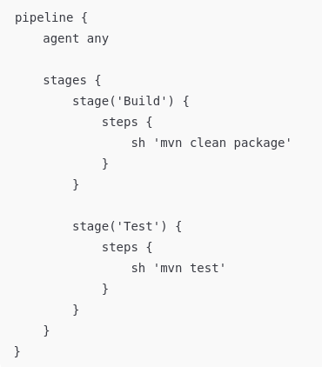
Declarative Pipeline
Characteristics
  Structured DSL (Domain Specific Language)
  Opinionated and constrained
  Validated before execution
  Easier to read
  Easy to develop standardized templates
Advantages
  Safer defaults
  Better visualization
  Easier onboarding
  Better governance

Slide 6
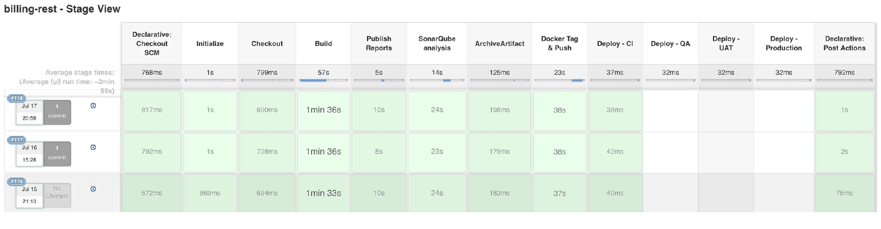
Declarative Pipeline
Integrates with Jenkins UI for graphical reporting
  Various plugins allow detailed feedback

Slide 7
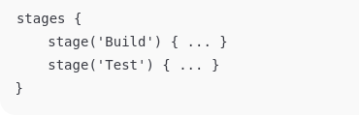
Stages
Stages represent the logical structure of the pipeline
  Enclosed in a “stages” block
Stages represent phases of the pipeline usually
  Build
  Test
  Scan
  Deploy
Stages can be whatever we want them to be
  As long as it represents some logical stage in the pipeline
Stages provide
  Clear visualization
  Failure isolation
  Easier troubleshooting

Slide 8
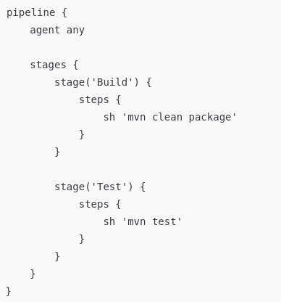
Pipeline Steps
A step is the smallest unit of work in a Jenkins pipeline
Steps
  Execute actions
  Run commands
  Interact with Jenkins features
  Integrate with tools and plugins
  Only one steps{} block per stage
Steps are always defined inside a stage
Stages organize work, but steps do the work

Slide 9
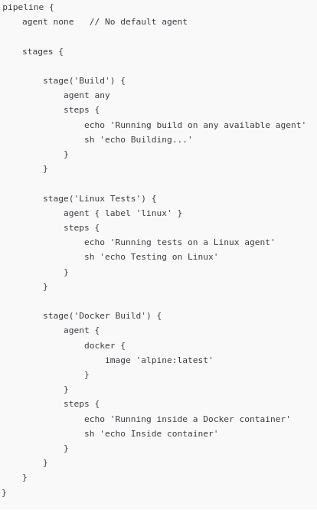
Agents
The agent defines where a pipeline or stage executes
  Common options
    “agent any” means any available agent
    “agent none” means the stages define agents
  Labeled agents
    Runs on an agent with a specific label
    Labels are assigned when an agent is defined by Jenkins
  Docker or Kubernetes agents can be created that provide specific types of execution environments
In the example shown, each stage
  Gets its own execution environment
  Is scheduled independently
  Releases its agent after completion

Slide 10
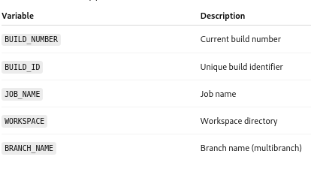
Environment Variables
Key–value pairs that
  Provide configuration information to a pipeline
  Control behavior without changing code
  Are available to steps at runtime
  Provide a shared context for a pipeline execution
Built-in Jenkins variables
  Jenkins automatically provides variables that provide information about Jenkins, the build, the run, and other related information
  The example shows some typical ones
  Referenced with the $VAR notation

Slide 11
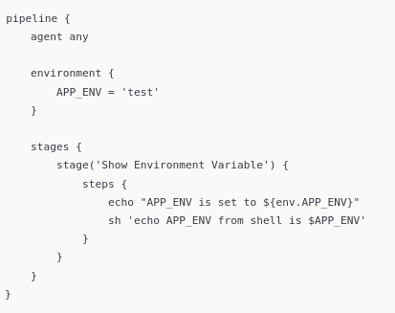

Environment Variables
Variables are defined directly in a pipeline
  Defined in an “environment” block
  Values are available throughout the pipeline
  Referenced in two different ways
echo "APP_ENV is set to ${env.APP_ENV}"
  This line runs inside Jenkins
    It’s evaluated by Groovy
    env is a Jenkins-provided object
    APP_ENV is read from Jenkins’ environment map
    Essentially “Ask Jenkins what the environment variable is.”
    Uses Groovy syntax
  Evaluated before any shell is started
  Used in:
    echo
    if conditions
    variable assignment
    pipeline logic

Slide 12

Environment Variables
sh 'echo APP_ENV from shell is $APP_ENV'
  This line starts a shell process on the agent
    $APP_ENV is expanded by the shell
    Jenkins injects the environment variable into the shell’s environment
    Essentially “Ask the operating system what the variable is.”
  Uses shell syntax
    Evaluated by /bin/sh (or similar)
  Used in:
    Build tools
    Scripts
    Command-line utilities
  Groovy (Jenkins) evaluates env.VAR
  Shell (Agent) evaluates $VAR

Slide 13
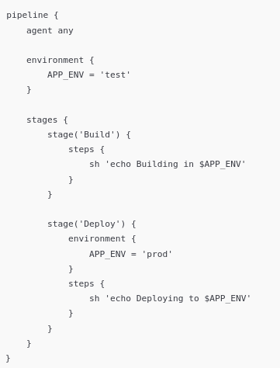
Environment Variables
Stage-specific environment variables
  Are defined inside a single stage
  Apply only to that stage
  Override pipeline-level variables if there is a conflict
    Referred to as “shadowing”
  Allows each stage to have its own configuration without affecting the rest of the pipeline.

Slide 14
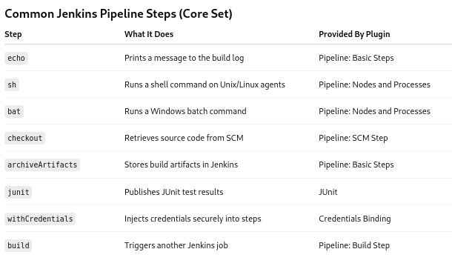
Steps and Plugins
Most steps come from plugins

Slide 15
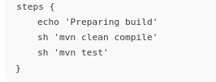
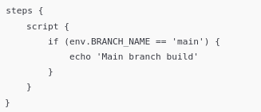
Step Execution
Multiple steps inside a stage run sequentially
If a step fails:
  The stage fails
  The pipeline usually stops
  Some steps (catchError, retry, timeout) modify this behavior
Allow controlled scripting using a script block
  The script{} block allows the insertion of Groovy code snippets into a declarative pipeline

Slide 16
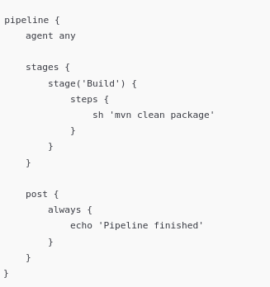
Post Stages
A post section defines actions that run after a stage or after the entire pipeline completes
Post stages are used for:
  Cleanup
  Notifications
  Reporting
  Finalization tasks
They ensure important actions happen regardless of pipeline outcome
Pipeline post stages execute at the end of a pipeline

Slide 17
Post Stages
Stage level post
  Post stages can also be defined after a stage
  Runs after a specific stage finishes

Slide 18
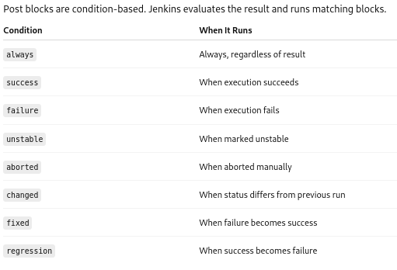
post Conditions
Post stages define what should happen after the main work completes
  Based on the result of the stage or pipeline
  The stage performs the actual build work
  The post block decides what to do with the result of the work done by the pipeline or stage
  More than one post block can execute
Post stages usually handle tasks like
  Notifications
  Cleanup
  Recovery from failed builds
  Delivering the artifact to a repository

Slide 19
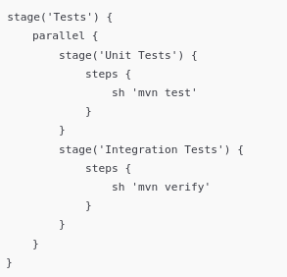
Parallel Stages
Allow Jenkins to run multiple stages at the same time instead of sequentially
Used when
  Tasks are independent
  Results don’t depend on each other
  Faster feedback is desired
Parallel stages reduce pipeline runtime by doing independent work concurrently

Slide 20
Parallel Stages
Parallel execution is defined inside a stage using a parallel block
Each nested stage
  Has its own name
  Has its own steps
  Runs concurrently with the others
Jenkins schedules each parallel stage independently
Each parallel stage
  Requires its own executor
  May run on a different agent

Slide 21
Parallel Stages
If any parallel stage fails, the parent stage fails
Other parallel stages may
  Continue running
  Be aborted (depending on configuration)
The pipeline moves on only after all parallel work completes or is stopped

Slide 22
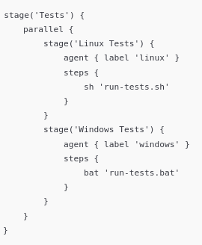
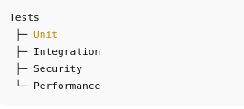
Agents and Parallel Stages
Parallel stages can
  Share the same pipeline agent
  Define their own separate agents
This allows
  Platform-specific execution
  True parallelism across environments
Common use cases
  Test matrix execution (discussed later)
  Multi-platform builds
  Tasks that can be done independently of a build
    Code Quality scans
    Security scans

Slide 23
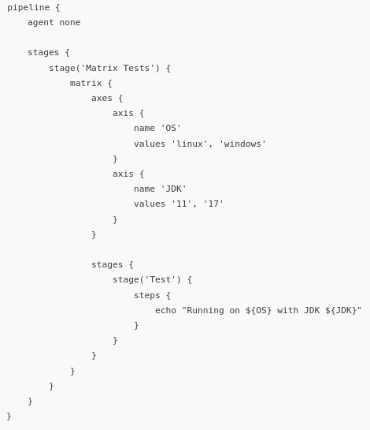
Matrix Builds
A matrix build runs the same pipeline logic multiple times using different combinations of variables
  A matrix build defines a set of axes (variables)
  Jenkins runs the pipeline once for each combination
Matrix builds test many variations of the same workflow automatically
The example on the right generates four executions
  linux + JDK 11
  linux + JDK 17
  windows + JDK 11
  windows + JDK 17

Slide 24
Executing Matrix Builds
Jenkins expands all axis combinations
Each combination (cell)
  Runs as an independent execution
  Has its own environment variables
  Each axis value becomes an environment variable
  Can run in parallel
  Results are aggregated in the UI
  A failure in one matrix cell
    Marks that cell as failed
    Does not stop other combinations
  Overall stage result reflects combined outcomes

Slide 25
Questions

